Slide 1
The Right Plan

Slide 2
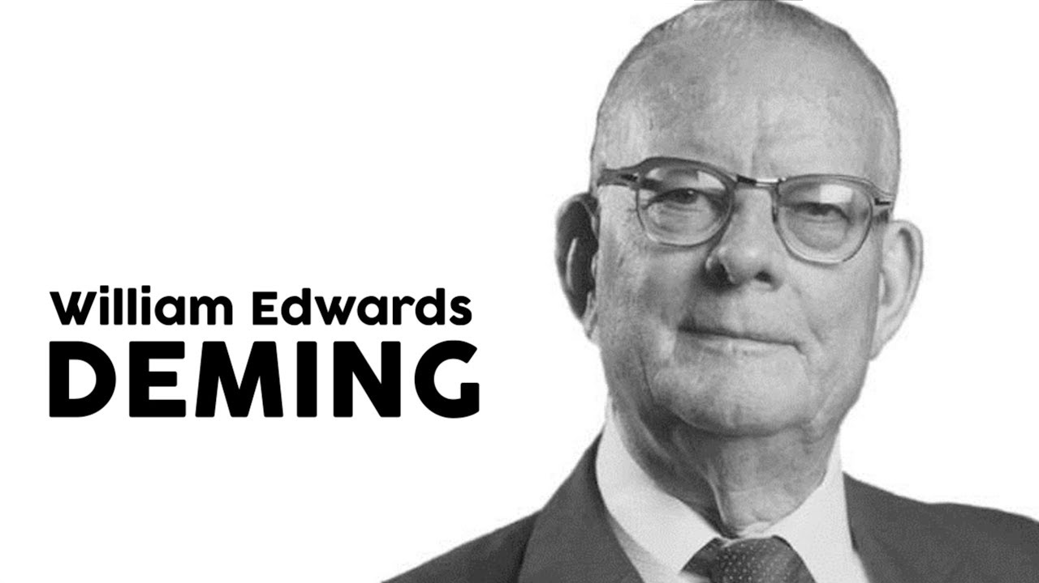
Keys to Success
Around 94% of the possible improvements belong to the system

Slide 3
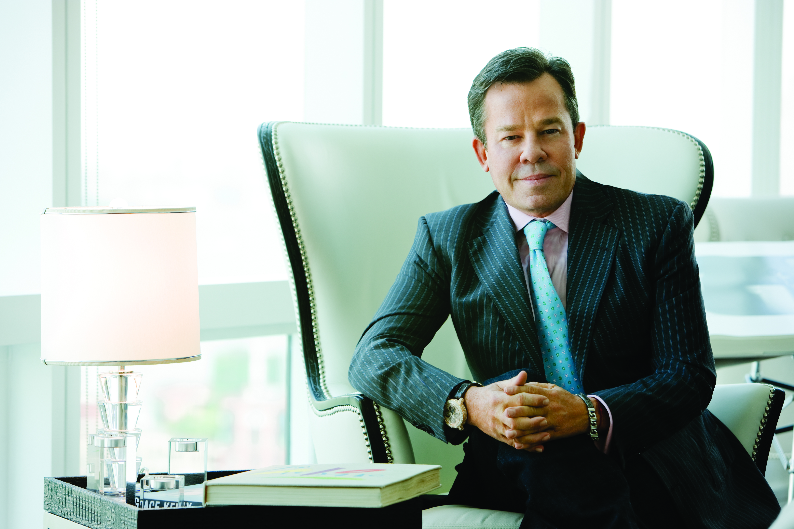
Founded Market America in 1992
Created the UnFranchise Business System and MPCP
Bring a significant change to entrepreneurs
JR Ridinger

Slide 4


Slide 5
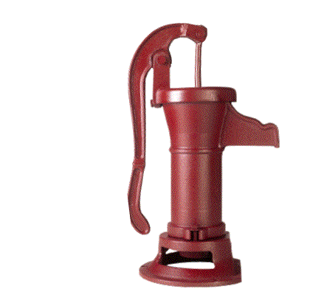
BINOMIAL PUMP WORKS PERFECTLY + SYNERGISTICALLY WITH THE ABC PATTERN
Notes:
YOU GET PEOPLE TO LEAD YOU TO THE RIGHT PEOPLE THROUGH TRIAL RUNS>>>>TEST MARKETING
USING EVALUATION APPROACH
SHOW THE PROGRAM
DETERMINE IF THEIR CONTACTS KNOW THE RIGHT PEOPLE
TEST MARKET THE PRODUCT

Slide 6


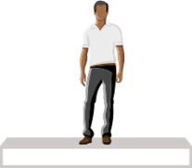

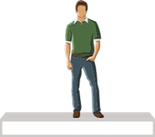








HORIZONTAL MARKETING STRUCTURE
REAL ESTATE, INSURANCE, SALES,
TRADITIONAL BUSINESS
ALL IN COMPETITION

Slide 7
VERTICAL MARKETING STRUCTURE
ENCOURAGES TEAMWORK
ALL WORKING TOGETHER
EVERYONE RECEIVES 100% CREDIT FOR SALES AND VOLUME GENERATED
EARNING POTENTIAL IS NOT
DETERMINED BY POSITION

Slide 8

Proven business plan
Immediate retail profits and Cashback
Volume search to infinity
Business Volume (BV) accrues for 365 days (Monthly Accrual Option)
Volume and people placement
Commissions calculated weekly
Strengths of THE
Management Performance Compensation Plan (MPCP)

Slide 9
Ability to earn more than
senior partners
Own multiple Business Development Centers (BDCs)
Business is a willable asset
Organisational structure creates common vested economic interest
Build only two organisations in depth to create ongoing
significant income
Grow your business globally
Strengths of THE
Management Performance Compensation Plan (MPCP)

Slide 10
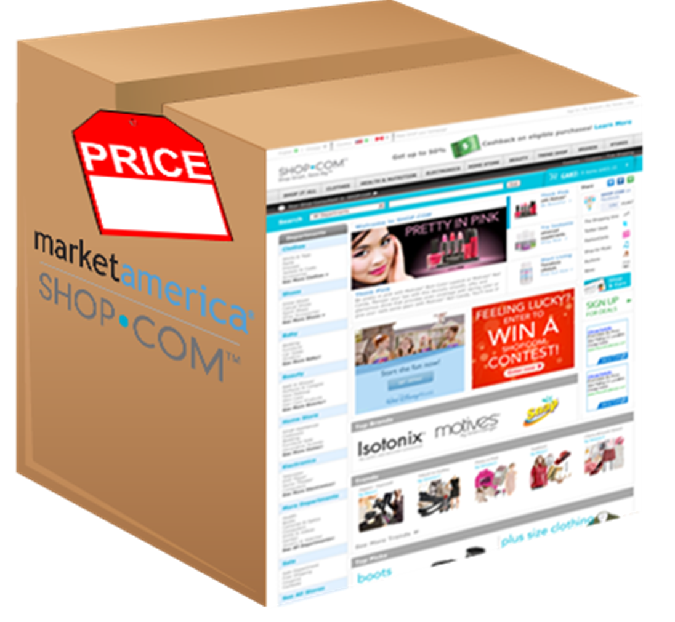

Win at the starting line

Slide 11
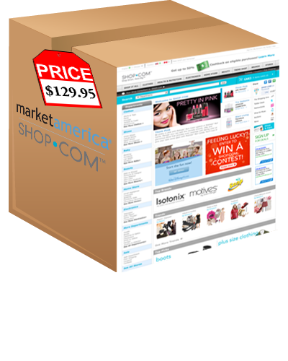
$
$
$
$
$
$

Slide 12

WORKING TOGETHER

Slide 13

Profit
Stability

Slide 14
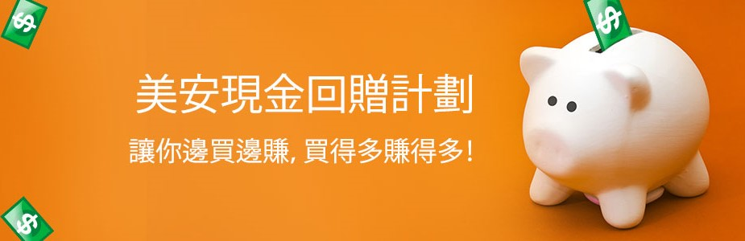
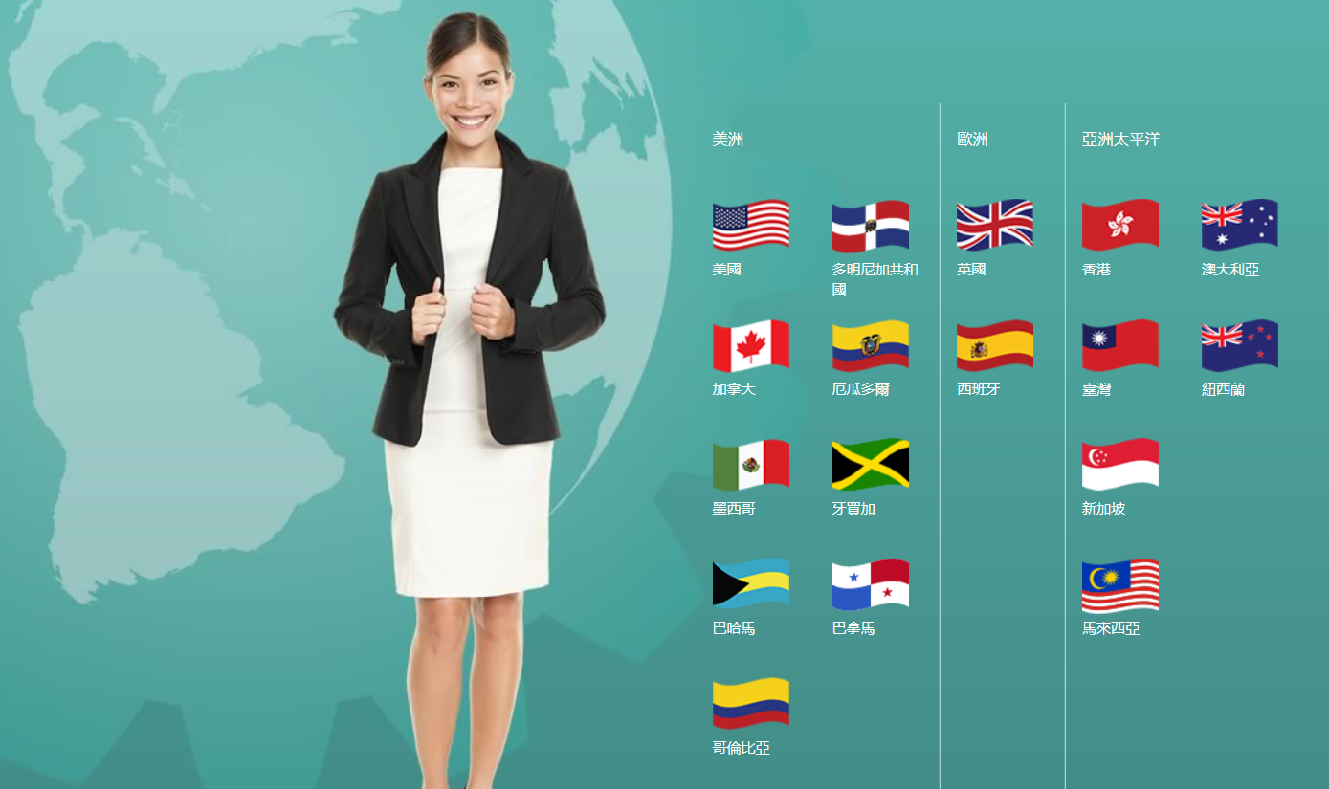


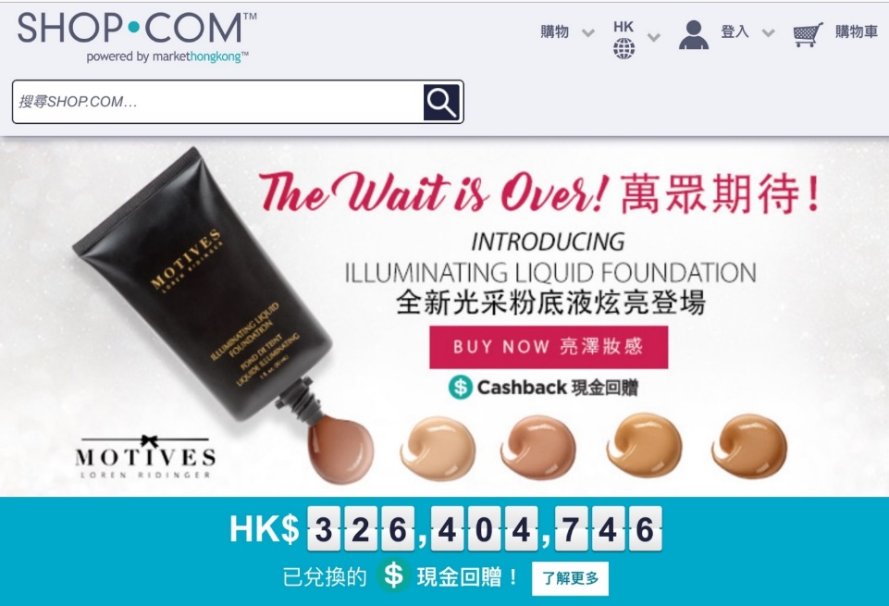
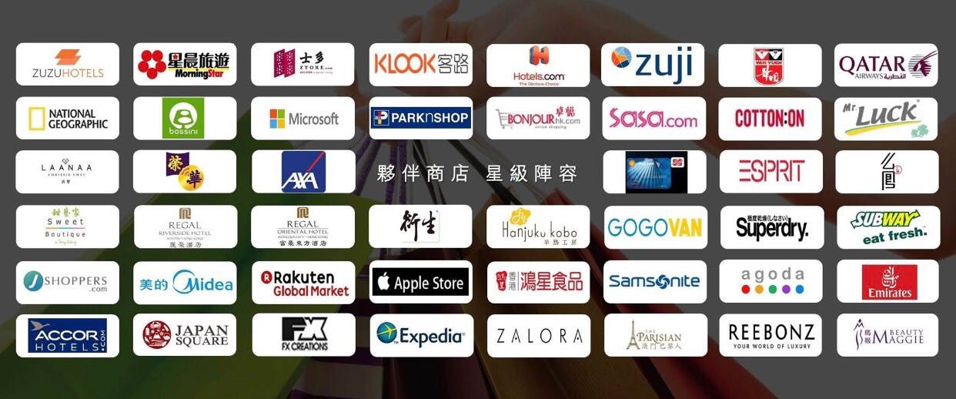
Win-win situation
Preferred Customers
UnFranchise Owners
MHK Cashback program
Buy more, you can earn more!
hk.shop.com
Partner stores

Slide 15

WE HAVE
WHAT NO ONE
ELSE HAS
Market America’s
keys to success
THESE 6 THINGS REQUIRED & WHY
WE CAN DO THE SHOPPING ANNUITY!
WE ARE THE DISRUPTER.

Slide 16
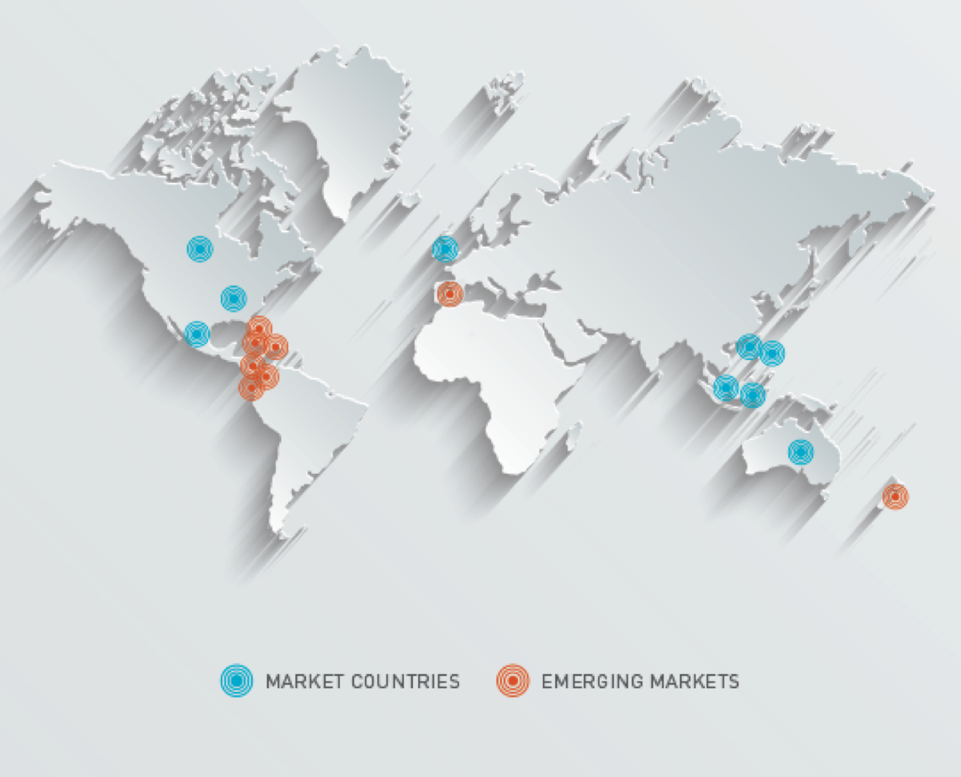
1
MONITIZED NETWORK
160,000 entrepreneurs
6 million connected customers
Changes your social network into your financial network

Slide 17
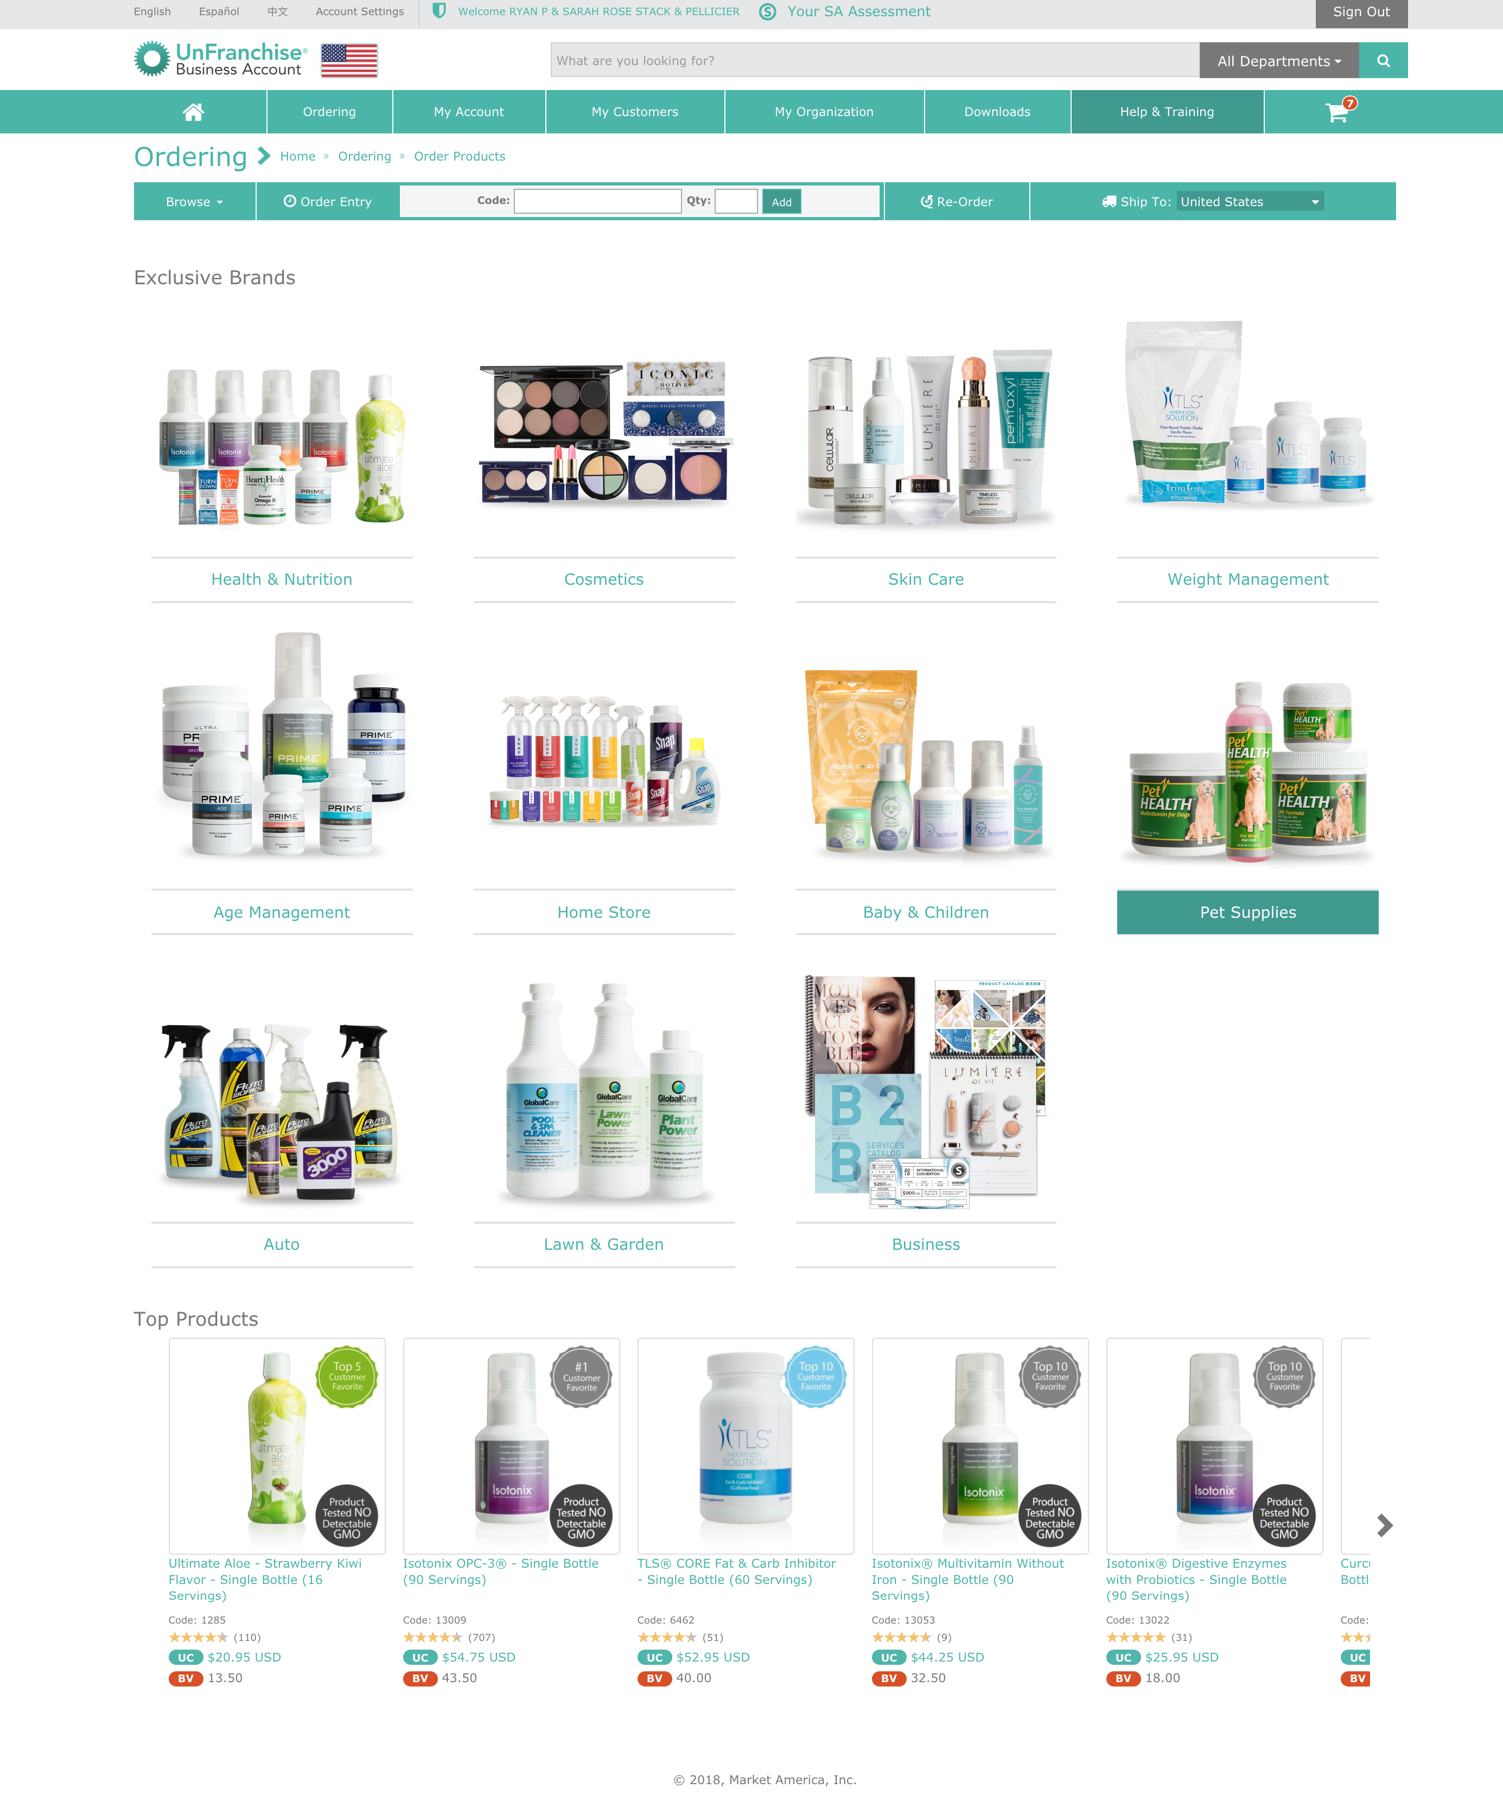
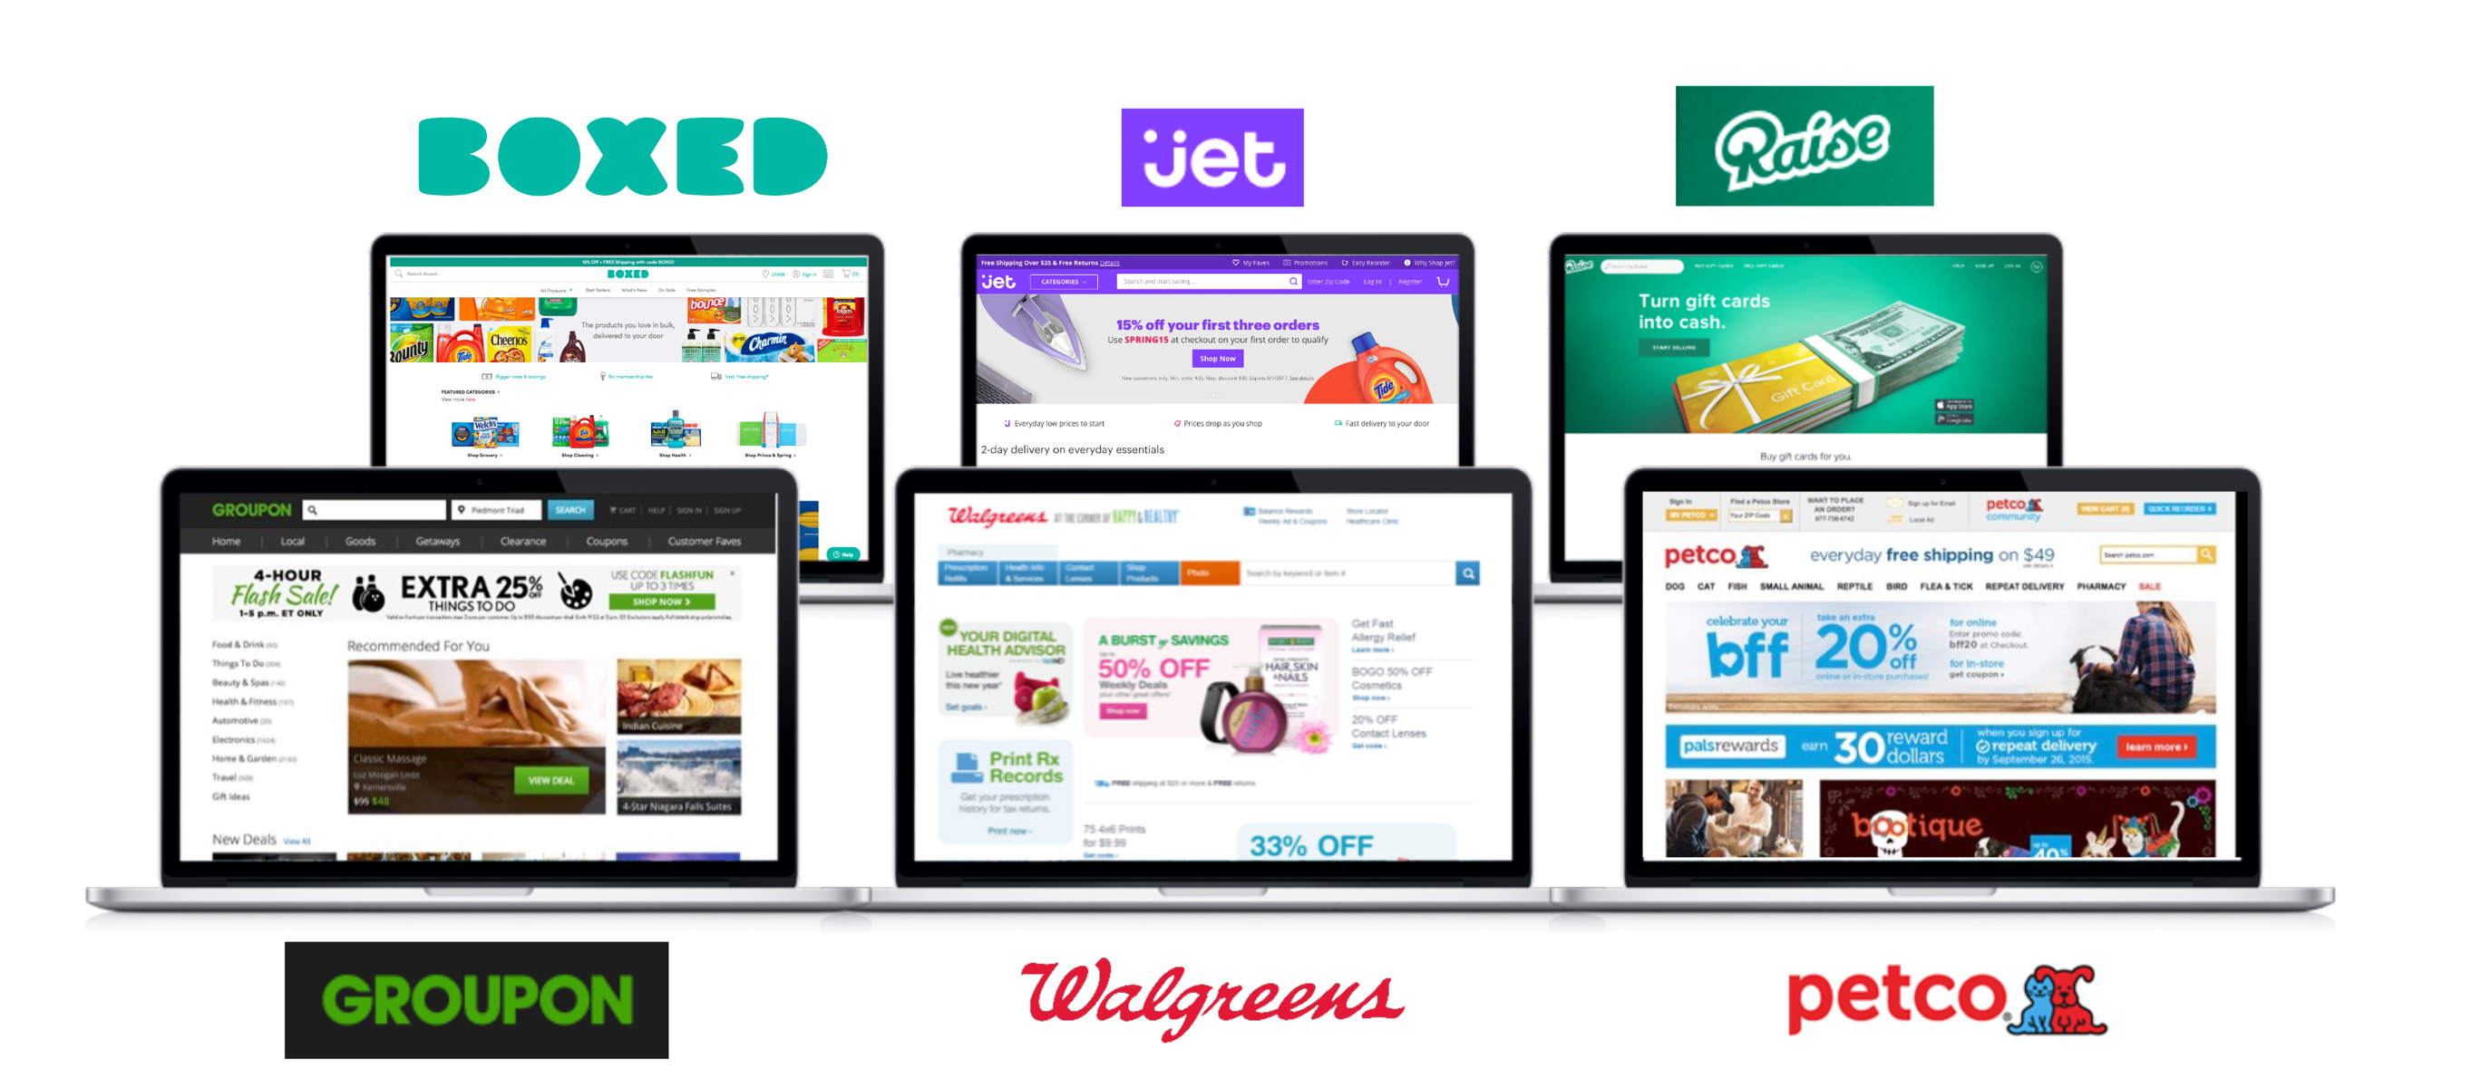
2
PRODUCTS
Everything that one needs to buy to live
Market America Brands
Shopping Annuity Brands
SHOP.COM(All other top Brands)
Having all kinds of daily products

Slide 18

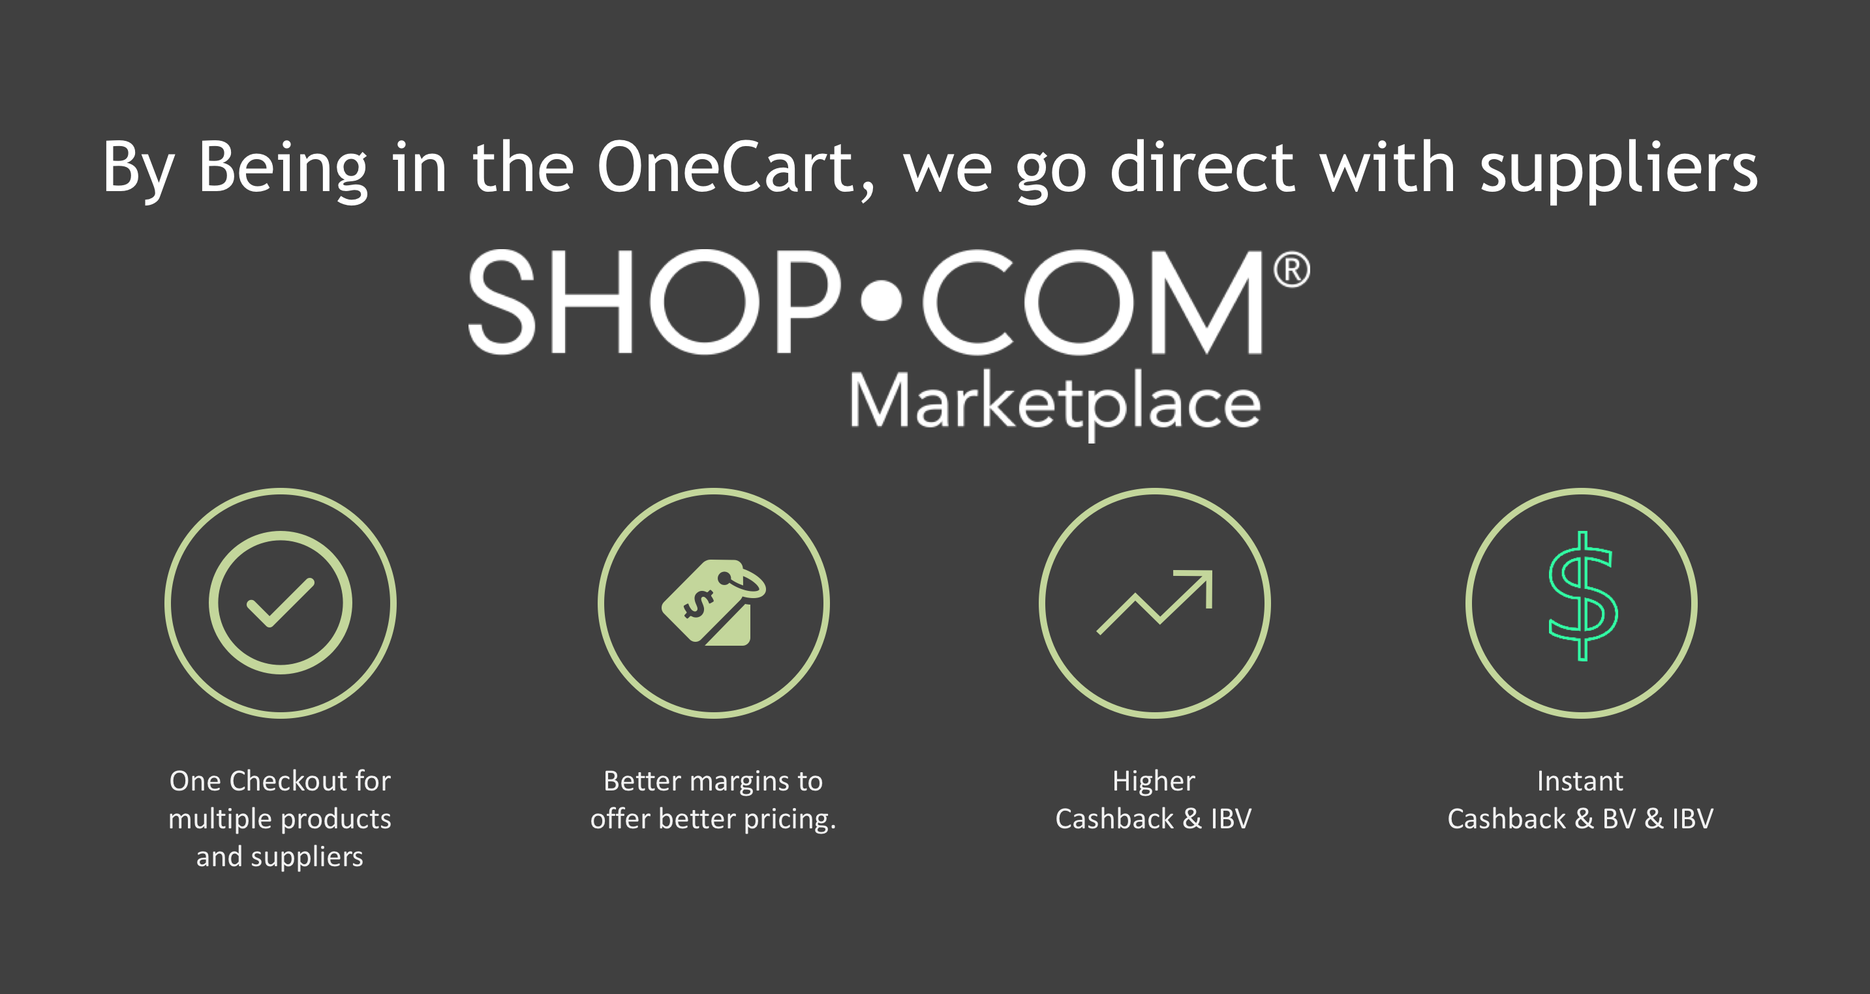
3
UNIVERSAL SHOPPING CART
ONLY A COUPLE OUT THERE LIKE AMAZON AND SHOP.COM
One-stop
shopping experience

Slide 19

4
TRACKING SYSTEM
YOUR (UFO’s) FOOTPRINT – MOVIE EXAMPLE - ORGANIC
VENDORS, PARTNERS, BRANDS, MERCHANTS, EXCLUSIVE BRANDS
WHEN YOU COMBINE THEM THE 2 OF THEM?
Tracking System

Slide 20
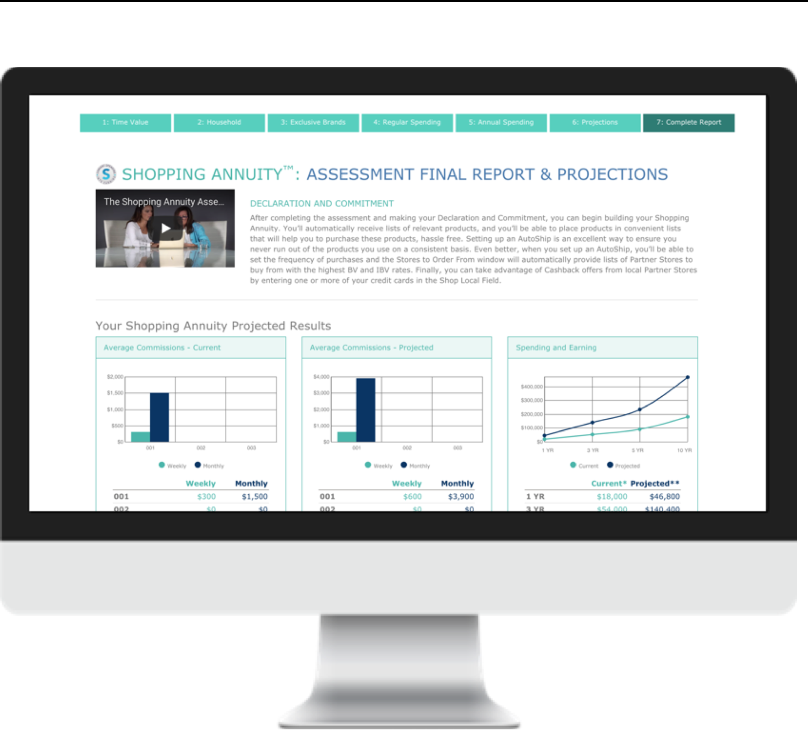
5
ASSESSMENT
ASSESSMENT TOOL TECHNOLOGY TO IDENTIFY SPENDING AND MATCH PRODUCT TO PEOPLE AND PEOPLE TO PRODUCT
Evaluate &
analyse

Slide 21
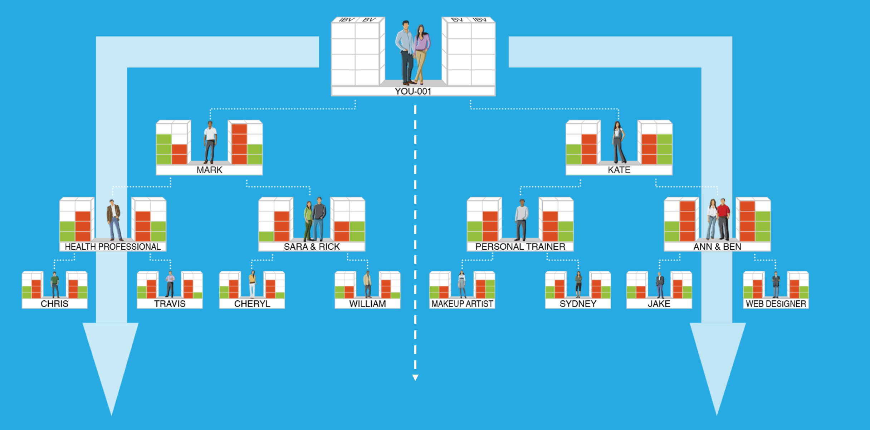
6
MPCP
FINANCIAL VEHICLE OR TECHNOLGY TO CONVERT INTO RESIDUAL INCOME = MPCP
THE UNFRANCHISE® BUSINESS
Management Performance Compensation Plan

Slide 22


